Slide 1


Spaceship Titanic
Team 3
1. Onyedikachi Onwuachuke (22021169) 2. Funmilola Olatoun Adetuwo (22026993)
3. Friday Odeh Ovbiroro (22034665)
4. Chuka Anthony Ibe (22024193)
5. Awofisayo Victoria Oladipo (22029348)
6. Nsude Albert Chimezie (22020699)
7. Borokini Adeola Samuel (22023817)
Colab Link: https://colab.research.google.com/drive/1-CjgFh6rgPULjNo2LTwd5kktSsc--VHe?usp=sharing
GitHub Link: https://github.com/ShootingStars9ja

Slide 2

INTRODUCTION
This group, SHOOTING STARS, is tasked to use the spaceship dataset retrieved from its computer system to predict which "passengers" were "transported" (target variable) successfully to the alternate ship using…
Spaceship Titanic Datasets files of train.csv and test.csv
Exploratory Data Analysis was used to understand the distribution, relationship and anomalies within the datasets
Decision Tree Classifier, Logistic Regression, XGboost Classifier, H2O AutoML were all employed in this classification Learning
Explainable AI (XAI) techniques was applied for interpretability.
SHapley Additive explanations were used to provide insights into the contributions of individual features
The results details the performances like accuracy, precision, recall and confusion matrix

Slide 3
Literature Review
Exploring existing literature provides valuable insights into methodologies and approaches that can be applied to similar problems. Key references include:
Ai, Y. (2023) in "Predicting Titanic Survivors by Using Machine Learning" investigated forecasting Titanic passenger survival using Logistic Regression, K-Nearest Neighbor (KNN), and Support Vector Machine (SVM) models. Using Kaggle data, the study achieved a 79.12% test accuracy with Logistic Regression. It highlighted the importance of feature engineering, exploratory data analysis (EDA), data cleansing, and hyperparameter tuning.
Jingyi, W. (n.d.) in "Survival Probability Assessment using Machine Learning Algorithms" predicted Titanic passenger survival using Decision Tree and K-Nearest Neighbor (KNN) algorithms. The Decision Tree achieved 81.72% accuracy, emphasizing the importance of data preprocessing. Using Titanic passenger statistics, the study highlighted critical factors for survival and the significance of algorithm selection and preprocessing techniques in survival predictions, offering a thorough analysis of the survivor population.
Decision Trees and Naive Bayes algorithms were used by Nadine et al. (2018) in "Predicting the Survivors of the Titanic Kaggle, Machine Learning From Disaster" to forecast Titanic passenger survival with Kaggle data. The study achieved 90.01% accuracy with Decision Tree and 92.52% with Naive Bayes. It found survival rates highly correlated with ticket type and sex, but the number of relatives traveling did not impact classification. This study showed how feature engineering and machine learning techniques create reliable predictive models for water disasters.

Slide 4
Objective and Problem Statement
Objective
The primary objective of this project is to develop a predictive model that can accurately determine whether a passenger was transported to an alternate ship based on various features.
Problem Statement and importance
The task involves predicting the binary outcome of whether a passenger was transported to an alternate dimension (Transported) based on features such as HomePlanet, CryoSleep, Cabin, Destination, Age, VIP, etc. This prediction problem is framed as a supervised classification task, where passengers are either transported or not transported.
Accurate prediction of passenger transportation status is important for designing safer and more efficient space travel protocols and guiding resource allocation and service improvements on future journeys.

Slide 5

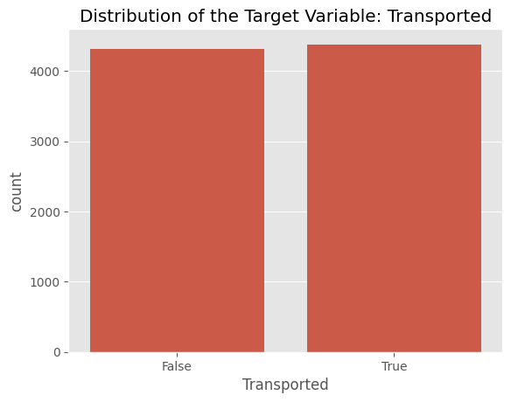
Exploratory Data Analysis
EDA is performed to uncover patterns, identify anomalies, and gain insights into the dataset.
Missing values are identified in features like HomePlanet, CryoSleep, Cabin, Destination, etc but were addressed using appropriate imputation techniques
The distribution of the target variable, Transported, using bar chart indicates that the counts for both True and False are almost equal.
Statistical Summary:
According to the value counts:
50.36% of the instances are labeled as "True" for being transported.
49.64% of the instances are labeled as "False" for not being transported.
This balance is crucial for training machine learning models to avoid bias towards one category.

Slide 6
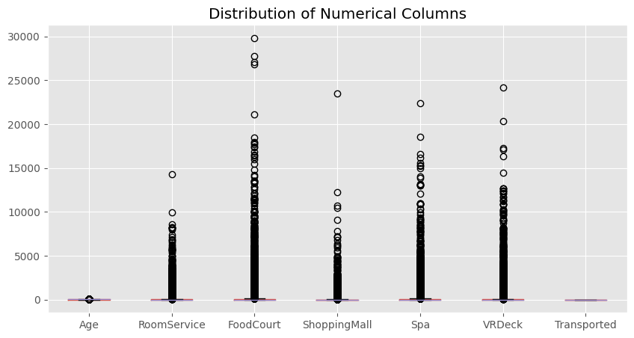
Exploratory Data Analysis
The distribution of the numerical variable, using a Plot Box
Statistical Summary
- Extreme values are present in the data.
- These extreme values indicate a skewed distribution for expenditure variables:
- RoomService
- FoodCourt
- ShoppingMall
- Spa
- VRDeck
- The Age variable shows a more uniform distribution.
- The Transported variable also shows a uniform distribution without significant skewness.

Slide 7
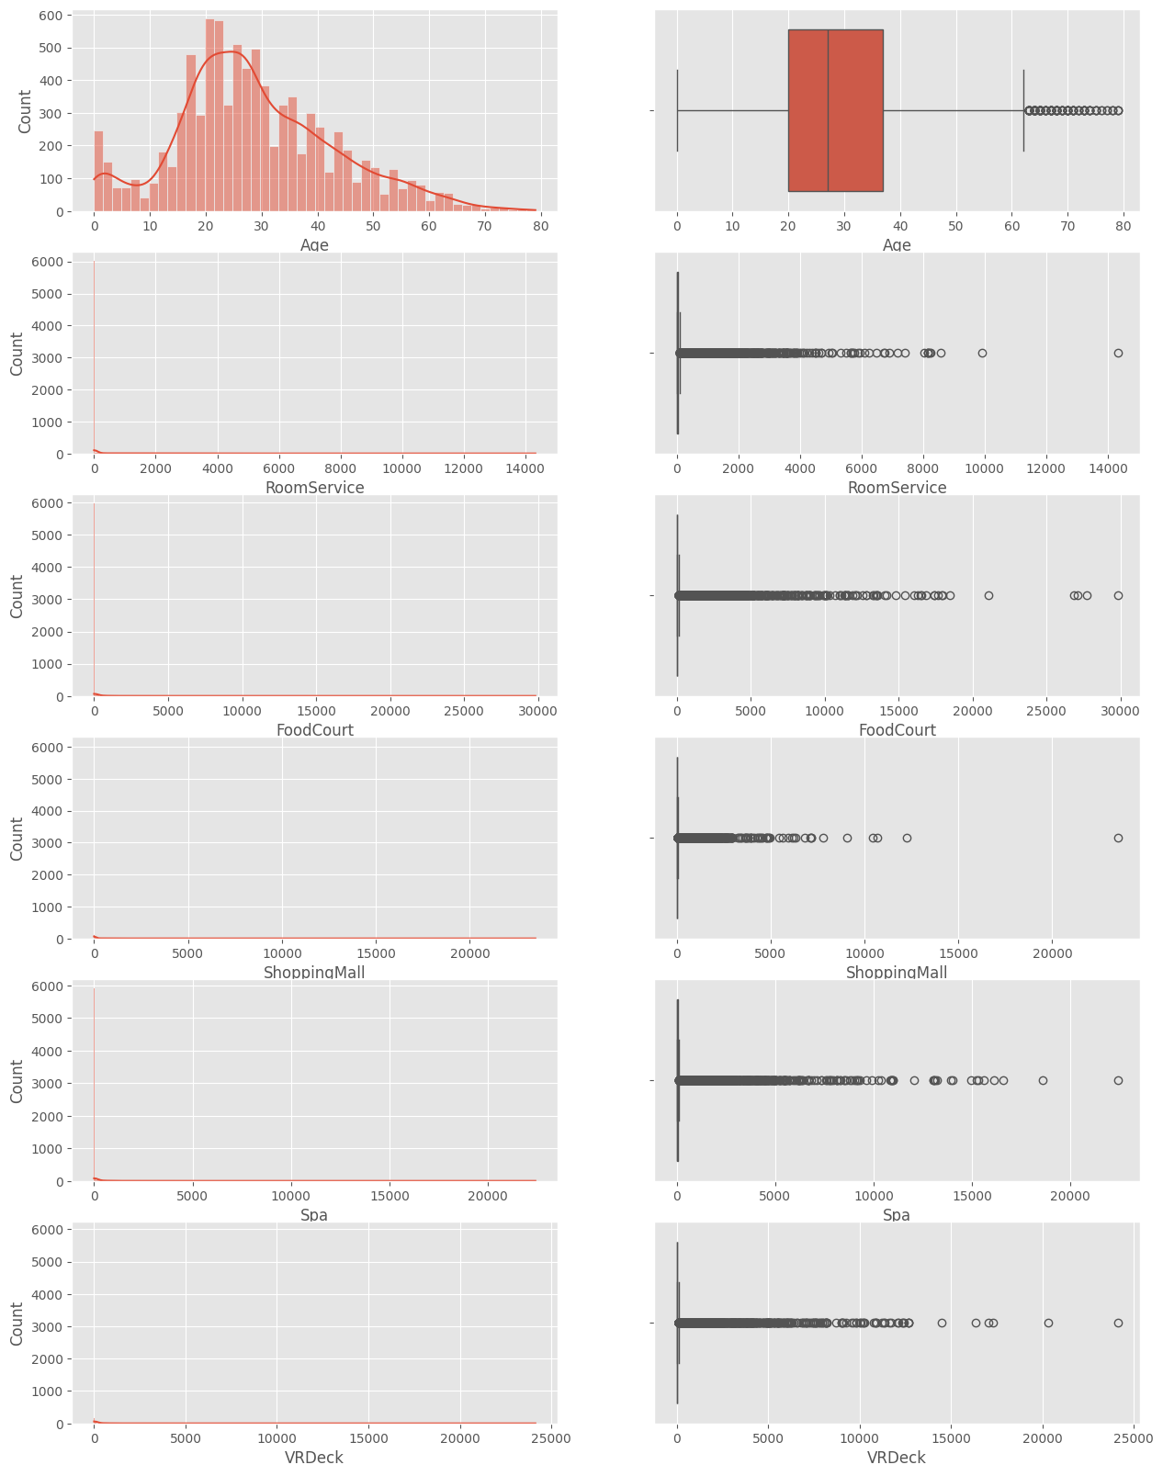
Exploratory Data Analysis and Insights
Target Variable
Transported: The distribution shows a balanced dataset, indicating no need for data balancing.
Numerical Features
Age: Clusters around younger ages with a slight skew towards younger passengers. Few older passengers are present.
RoomService, FoodCourt, ShoppingMall, Spa, VRDeck: Most values are zero or very low, with a few extreme outliers indicating high spending.
Categorical Features
HomePlanet: Most passengers are from Earth, followed by Europa and Mars.
CryoSleep: Majority do not use cryo-sleep.
Destination: TRAPPIST-1e is the most common destination.
VIP: Few passengers are classified as VIPs.

Slide 8
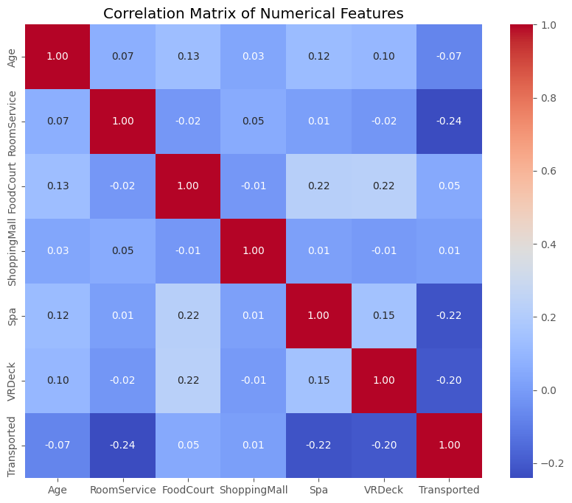
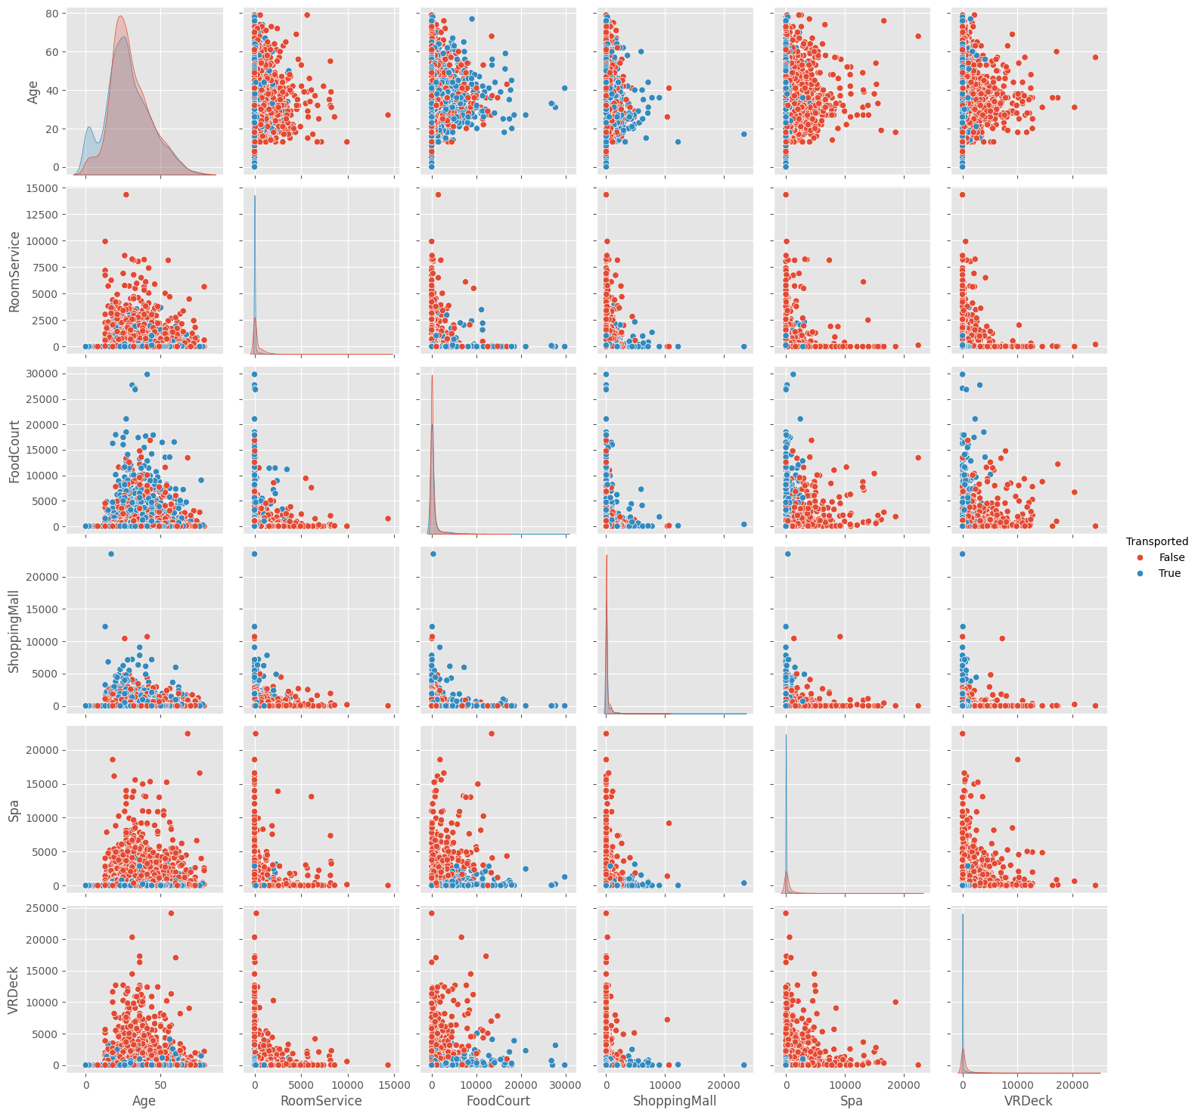
Exploratory Data Analysis and Insights
Correlation Matrix Insights
Age and Spending: Older passengers spend more on services like FoodCourt and VRDeck.
Spending Categories: High spending in one area often correlates with high spending in others.
Transported: Passengers who were transported tend to spend less on RoomService, Spa, and VRDeck.
Pair Plot Insights
Age and Transported: Younger passengers are slightly more likely to be transported.
Spending and Transported: Passengers not transported spend more on RoomService, Spa, and VRDeck, suggesting leisure purposes.
Age and Spending: Older passengers generally spend more across various services

Slide 9
Exploratory Data Analysis and Insights
Visualization of EDA Insights
Histograms and Box Plots: Show the distribution and outliers in numerical data.
Count Plots: Visualize the frequency of categorical variables.
Correlation Heatmap: Highlights relationships between numerical features.
Pair Plots: Show relationships and distribution of features colored by the transport status.
Summary of the analysis
The dataset is balanced in terms of the target variable.
Spending features are highly skewed with many zero values and significant outliers.
Age shows a relatively uniform distribution with younger passengers being more common.
Categorical features reveal preferences and behaviors of passengers, such as the majority preferring TRAPPIST-1e and not using cryo-sleep.
Correlations indicate spending habits and their potential link to transportation status.

Slide 10
Data Pre-Processing
Preprocessing and preparing the data based on the insights and the undertstanding of our data to make it suitable for our Model.
We perform several steps of preprocessing on a DataFrame df_train before splitting the data into training and testing sets for a machine learning model
One-Hot Encoding: This converts categorical variables into binary vectors, each with a separate column with 0s and 1s.
Standard Scaling: Standard scaler scales numerical features so that they have a mean of 0 and a standard deviation of 1, which helps many machine learning algorithms perform better.
Feature and Target Separation: X contains all the features, and y contains the target variable (Transported).
Train-Test Split: The data is split into training (80%) and testing (20%) sets using train_test_split
X_train.info():
<class 'pandas.core.frame.DataFrame'>
Int64Index: 800 entries, 755 to 684
Data columns (total 20 columns):
# Column Non-Null Count Dtype
--- ------ -------------- -----
0 Feature1 800 non-null float64
1 Feature2 800 non-null float64
2 Feature3 800 non-null float64
3 Cat1_1 800 non-null float64
4 Cat1_2 800 non-null float64
5 Cat2_1 800 non-null float64
6 Cat2_2 800 non-null float64
7 Cat3_1 800 non-null float64
8 Cat3_2 800 non-null float64
9 Cat4_1 800 non-null float64
10 Cat4_2 800 non-null float64
11 Cat5_1 800 non-null float64
12 Cat5_2 800 non-null float64
13 Cat5_3 800 non-null float64
14 Cat5_4 800 non-null float64
15 Cat5_5 800 non-null float64
16 Cat5_6 800 non-null float64
17 Cat5_7 800 non-null float64
18 Cat5_8 800 non-null float64
19 Cat5_9 800 non-null float64
dtypes: float64(20)
Sample data:
Feature1 Feature2 Feature3 Cat1_1 Cat1_2 Cat2_1 Cat2_2 Cat3_1 Cat3_2 Cat4_1 ... Cat5_1 Cat5_2 Cat5_3 Cat5_4 Cat5_5 Cat5_6 Cat5_7 Cat5_8 Cat5_9
0 0.32 -1.25 0.87 1.0 0.0 0.0 1.0 0.0 1.0 1.0 ...
1 -0.85 0.42 -0.78 0.0 1.0 1.0 0.0 1.0 0.0 0.0 ...
2 0.47 0.23 1.12 0.0 0.0 0.0 1.0 0.0 1.0 1.0 ...
3 -1.12 1.33 -1.22 1.0 0.0 1.0 0.0 0.0 0.0 0.0 ...
4 1.45 -0.55 0.55 0.0 1.0 0.0 0.0 1.0 0.0 1.0 ...

Slide 11
Model Development
The machine learning models employed to solve these problems are as follows:
Logistic Regression: is a linear model used for binary classification tasks. It calculates the likelihood that a given input is a member of a specific class.
Decision Tree Classifier: The model creates a tree-like structure to make predictions by branching the data according to feature values.
Random Forest: An ensemble technique that constructs multiple decision trees and combines them to get a prediction that is more reliable and accurate.
Logistic regression: it was able to detect the "False" class which was marginally better than random guesswork.
Decision Tree: Balanced precision and recall for both classes considerably better.
Random Forest: Showing strong performance, along with great precision and recall for both classes.
Summary of model performances
Model Accuracy
0 Logistic Regression 0.504888
1 Decision Tree 0.756757
2 Random Forest 0.792409

Slide 12
MODEL SELECTION
An overview of H2O AutoML
It is an automated machine learning tool that simplifies the process of building and selecting the best predictive model.
Key Features:
Automated Model Training: H2O AutoML automates the process of training multiple machine learning models, including GLMs, Random Forests, Gradient Boosting Machines, Deep Learning, and Stacked Ensembles
Model Selection: Using a given performance metric—such as AUC, LogLoss, RMSE, etc.—it automatically chooses the optimum model.
Ensembling: By building stacked ensembles of the top-performing models, AutoML makes use of the ensembling process, which frequently produces better prediction performance.
Leader Board Table
The Stacked Ensemble model achieved the highest AUC of 0.8742, indicating the best performance in terms of distinguishing between the two classes. The model also performed well in terms of other metrics such as LogLoss, RMSE, and AUCPR, making it the most robust choice among the models evaluated.
Model ID | AUC | LogLoss | AUCPR | RMSE | MSE
StackedEnsemble_BestOfFamily_1_AutoML_1_20240709_190859 | 0.8742 | 0.4437 | 0.8850 | 0.3802 | 0.1445
StackedEnsemble_AllModels_1_AutoML_1_20240709_190859 | 0.8742 | 0.4420 | 0.8833 | 0.3794 | 0.1439
GBM_1_AutoML_1_20240709_190859 | 0.8730 | 0.4445 | 0.8842 | 0.3804 | 0.1447
GBM_2_AutoML_1_20240709_190859 | 0.8714 | 0.4470 | 0.8805 | 0.3810 | 0.1451
GBM_4_AutoML_1_20240709_190859 | 0.8710 | 0.4474 | 0.8773 | 0.3822 | 0.1461
GBM_3_AutoML_1_20240709_190859 | 0.8710 | 0.4468 | 0.8785 | 0.3820 | 0.1459
XGBoost_3_AutoML_1_20240709_190859 | 0.8676 | 0.4558 | 0.8781 | 0.3856 | 0.1487
XGBoost_2_AutoML_1_20240709_190859 | 0.8631 | 0.4607 | 0.8739 | 0.3898 | 0.1519
XGBoost_1_AutoML_1_20240709_190859 | 0.8625 | 0.4638 | 0.8736 | 0.3904 | 0.1524
DRF_1_AutoML_1_20240709_190859 | 0.8435 | 0.6125 | 0.8317 | 0.4585 | 0.2102

Slide 13
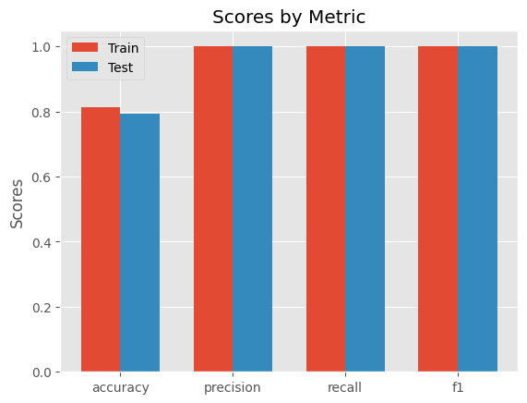
Explanable AI And Model Evaluation
This graph compares the model performance on the training and test data across different metrics:
Accuracy: Measures the proportion of correctly predicted instances.
Precision: Measures the proportion of positive predictions that were correct.
Recall: Measures the proportion of actual positives that were correctly identified.
F1 Score: The harmonic mean of precision and recall.
The model performs consistently across both the training and test datasets, indicating it is well-generalized and not overfitting.

Slide 14
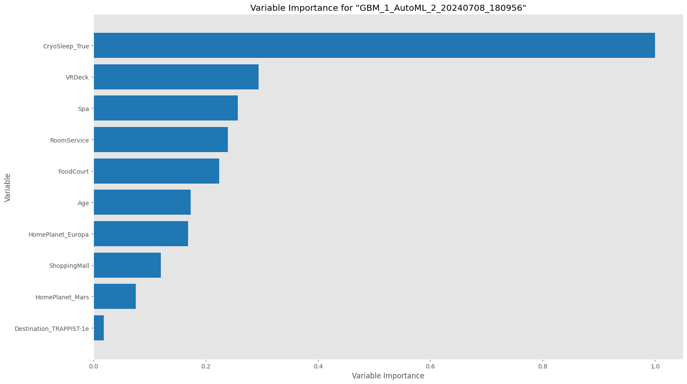
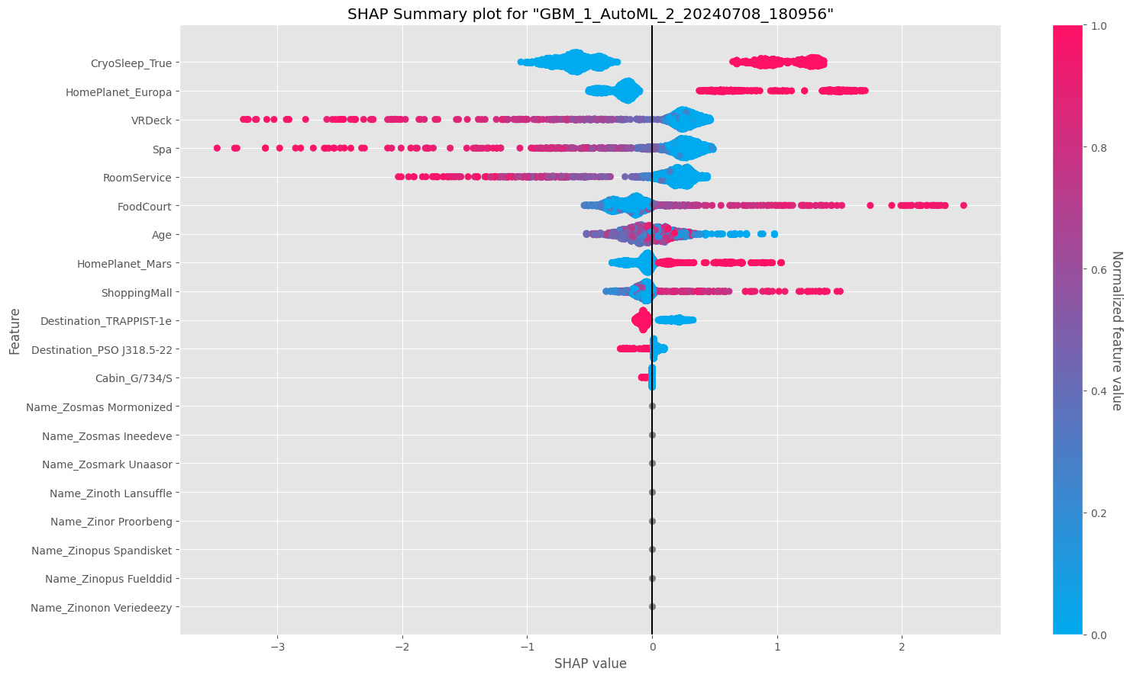
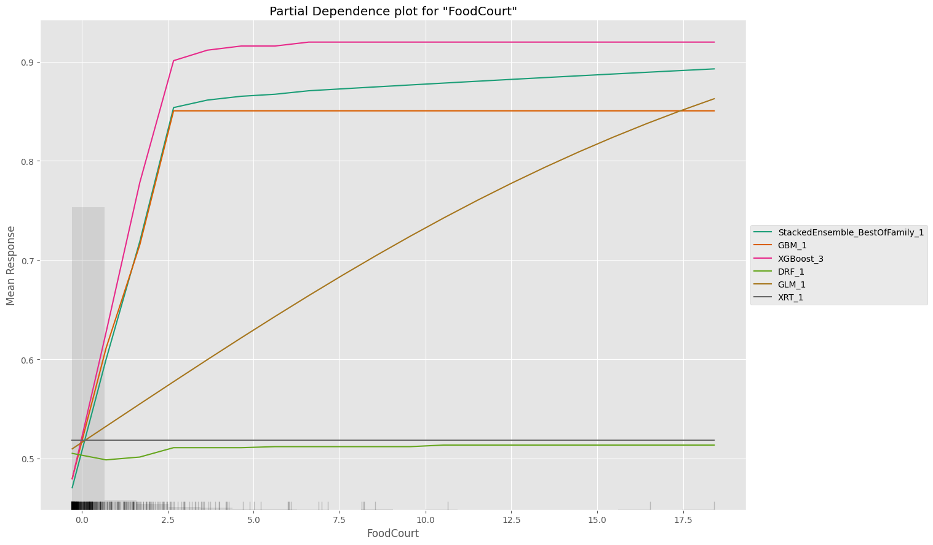
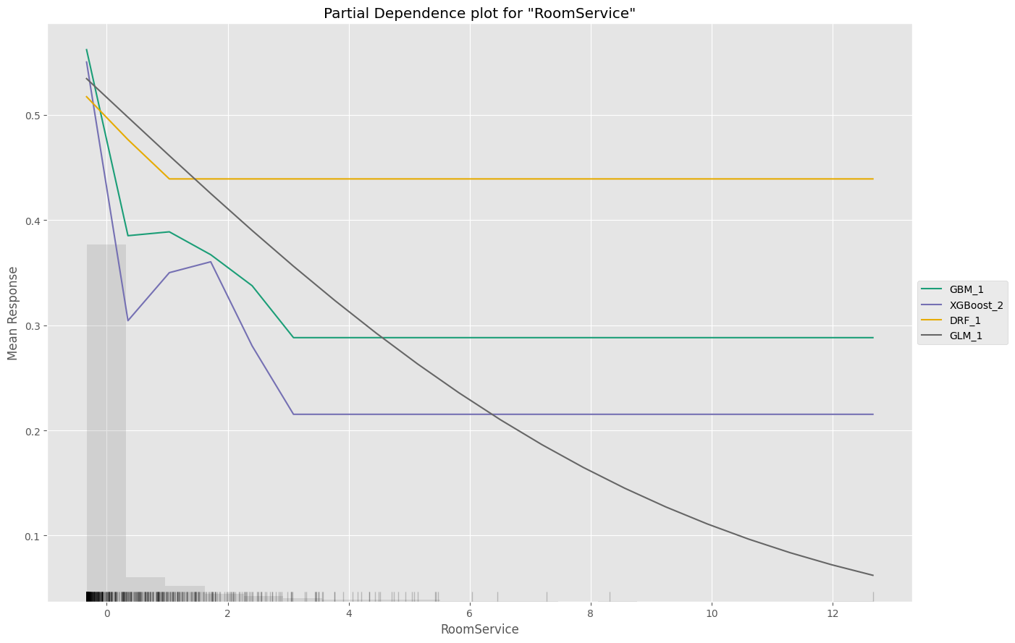
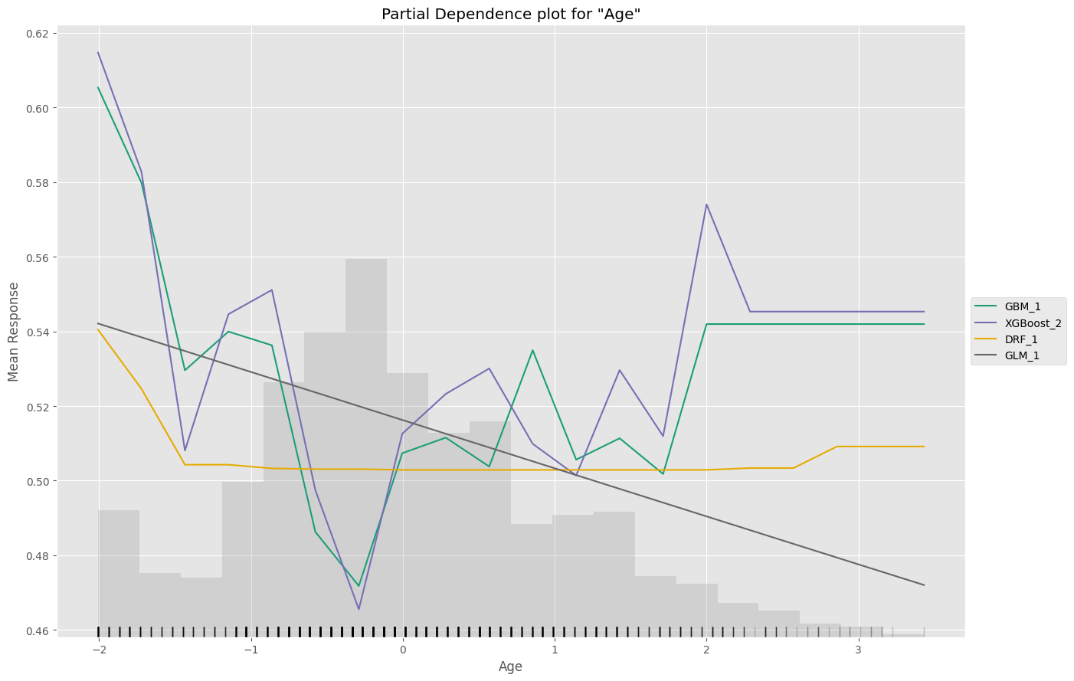
Explanable AI And Model Evaluation
The analysis demonstrates that the most influential factors in predicting the positive class are related to the passengers' spending habits in various amenities (VRDeck, Spa, RoomService, FoodCourt) and their CryoSleep status. Age and home planet also play significant roles but to a lesser extent. The partial dependence plots provide insights into how changes in these features affect the prediction probabilities, while the SHAP summary plot and variable importance plot highlight which features have the most substantial impact on the model's decisions. The model seems to be well-calibrated and performs consistently across different evaluation metrics.

Slide 15
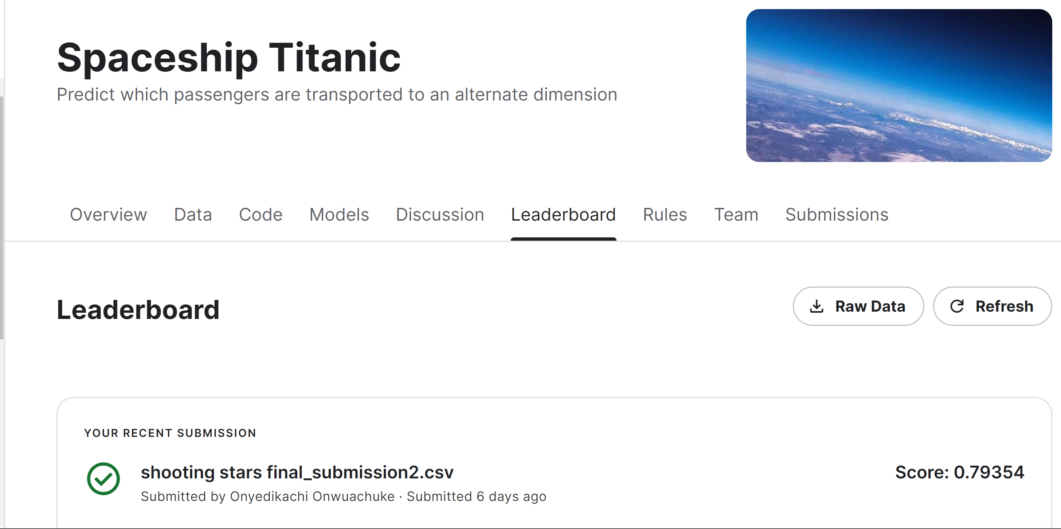
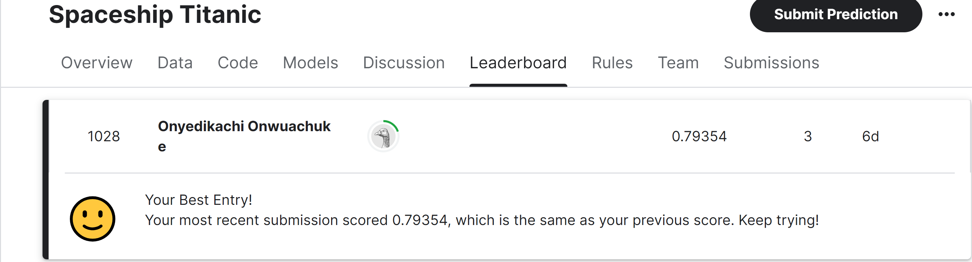
Preparing predictions
This performs several crucial preprocessing steps to prepare a test dataset for predictions with a machine learning model. It handles missing values, encodes categorical variables, scales numerical features, and ensures all data is in the correct format for model prediction. Finally, it generates and formats the predictions and extract the results needed for the submission to Kaggle
predict | False | True
True | 0.353309 | 0.646691
False | 0.969173 | 0.0308273
True | 0.0190777 | 0.980922
True | 0.104267 | 0.895733
True | 0.363912 | 0.636088
True | 0.335882 | 0.664118
True | 0.0190576 | 0.980942
True | 0.0272518 | 0.972748
True | 0.0234713 | 0.976529
True | 0.459125 | 0.540875

Slide 16
Conclusion
The task successfully demonstrated the application of AutoML techniques to build an accurate and interpretable predictive model for the Spaceship Titanic dataset.
Key findings include:
⮚ H2O AutoML's Effectiveness: The AutoML process efficiently selected the best model, a Stacked Ensemble, with AUC of 0.8742, highlighting the benefits of automation in machine learning.
⮚ Significant Predictors: Features such as Age, and other expenditures were identified as significant predictors of whether passengers were transported, providing actionable insights.
⮚ Balanced Performance Metrics: The model exhibited balanced performance metrics, making it reliable for binary classification tasks.
Despite the promising results, there are several limitations to consider like;
Data Imbalance: Certain subcategories within the dataset are imbalanced, despite the target variable (Transported) being reasonably balanced. The robustness of the model may be impacted, for instance, by the fact that some home planets or cabin classes have fewer instances than others.

Slide 17

Thank you

